Slide 1
Determinant Of a Matrix
Calculating and Comparing
Using various methods
Sarthak Agarwal

Slide 2

Why DETERMINANT?

Slide 3

Objective: Determine efficiency of Determinant calculation methods

Slide 4
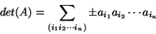
Definition of Determinant
Determinant of (n x n) a matrix and is a real or a complex number that is associated with many properties that the matrix possesses. One way to define the determinant of a (n x n) matrix A is the formula:
where the terms are summed over all permutations, and the sign is positive if the permutation is even, and for odd it is negative.

Slide 5

The Need
Extensive use of linear algebra and matrices in Computer Science often requires the programmer to find the most efficient algorithm to calculate determinant.

Slide 6
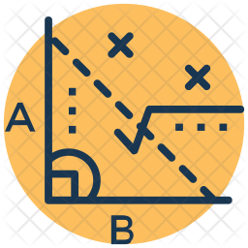


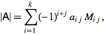
Methods to Calculate Algorithm
Special Matrix
(Diagonal Product)
Gaussian Elimination
Recursion
(LaPlacian Expansion)
Diagonal Matrix
Upper Triangular Matrix
Lower Triangular Matrix
Performing Basic Row Operations
Calculating minors of a matrix and calculating determinant using:

Slide 7
<CODE>
<CODE>

Slide 8

Gaussian Elimination
Recursion
(Minor)
Special Matrices
Analysis:

Slide 9
Thank You!
Sarthak Agarwal

